Slide 1
Cholera Forecasting Progress update
October 2024 Sisay Wondaya, EPHI

Slide 2
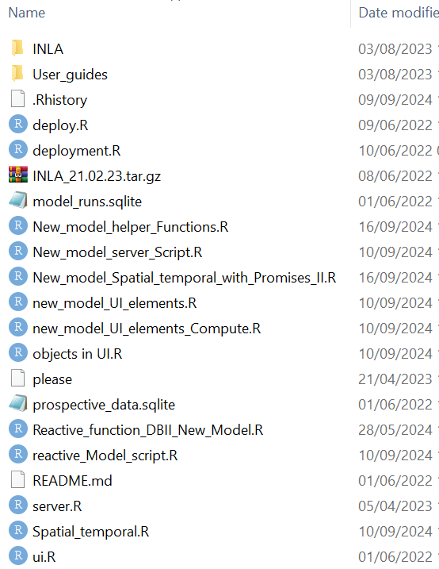
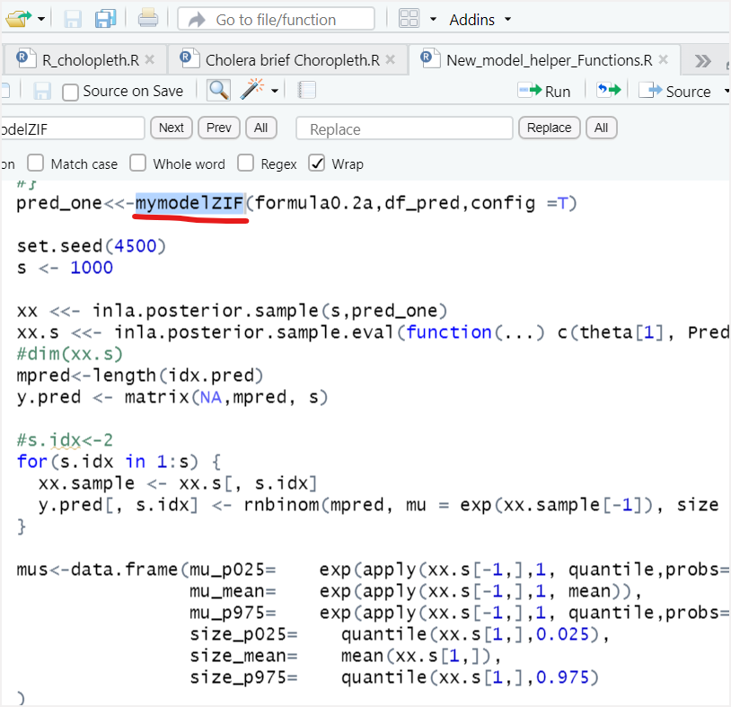
EWARS model customization
Model customization for cholera-specific parameters
Cholera-Specific Features: Incorporated variables like Temp, rainfall, OCV %
Threshold : set the endemic channel to be 1
Model: Appropriate model specification→ ZIF model
Forecasted Value: Exportation of forecast value for cholera brief

Slide 3
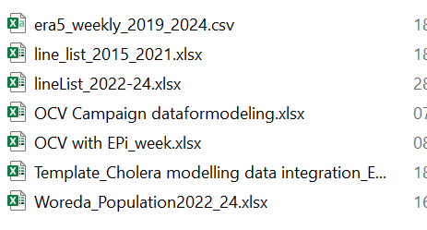
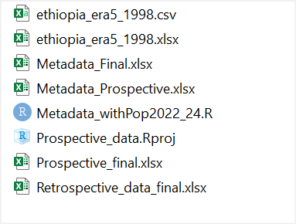
Data collection
Collected from different sources: Cholera unit, Metrology site, PHEM unit, Population data ESS, OCV %,…
Data were not complete & supposed to fill manually from google, Survey result, ESS,…
Note that Met data is collected from Era5 weather data center
Which is the European Centre for Medium-Range Weather Forecasts

Slide 4
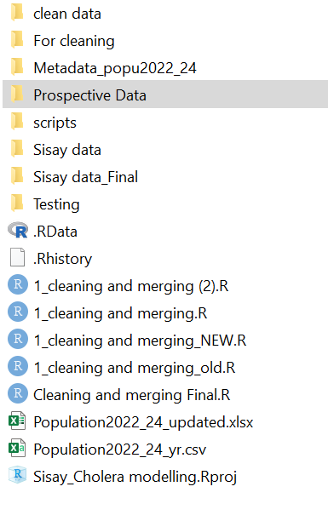
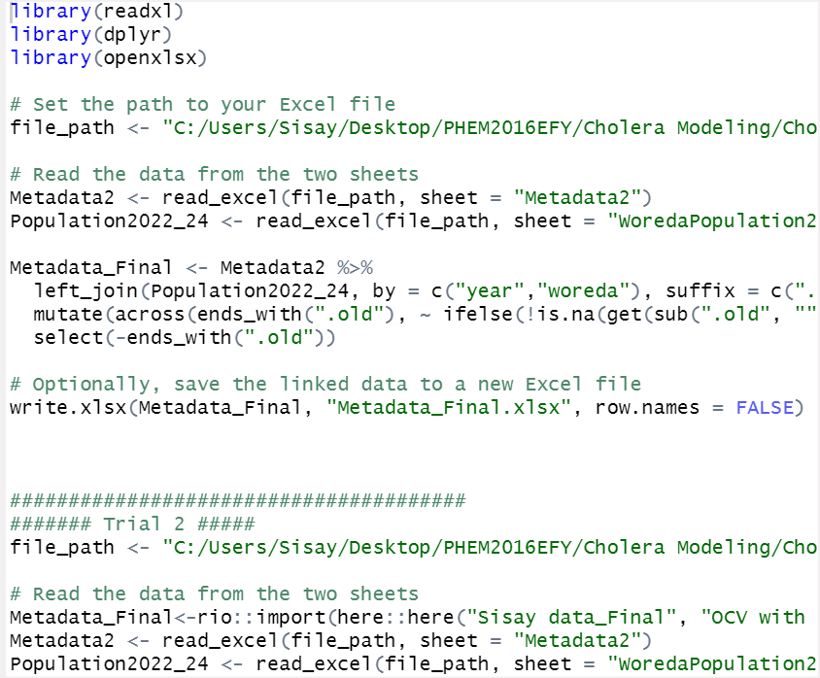
Data integration & cleaning
Together with Soo, we draft script for integration
However, further manual editing and cleaning was necessary
Missing, unrealistic data, inconsistent population, two or more different value for single cell, …etc

Slide 5
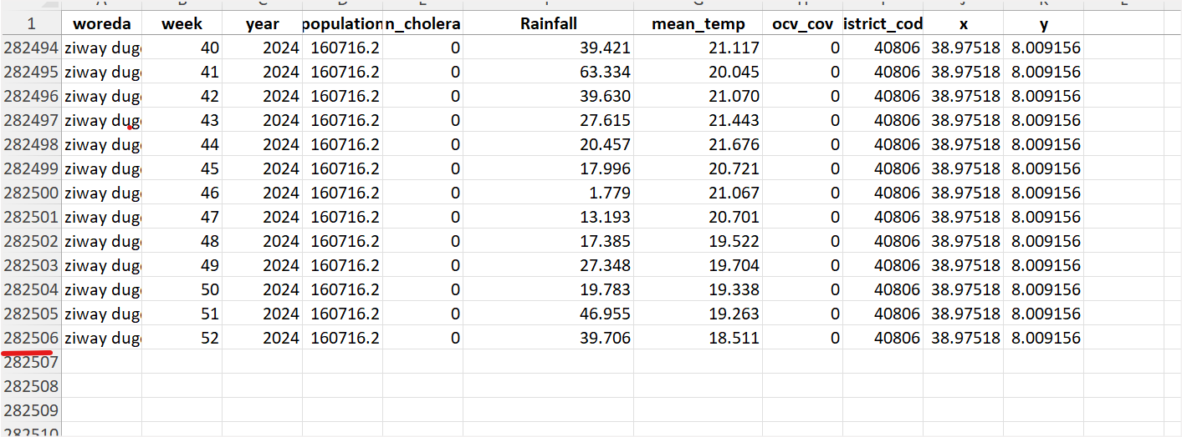
… Final compiled retrospective data

Slide 6
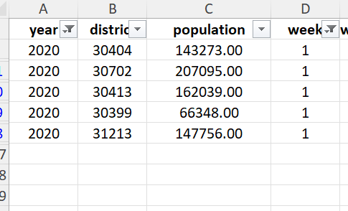
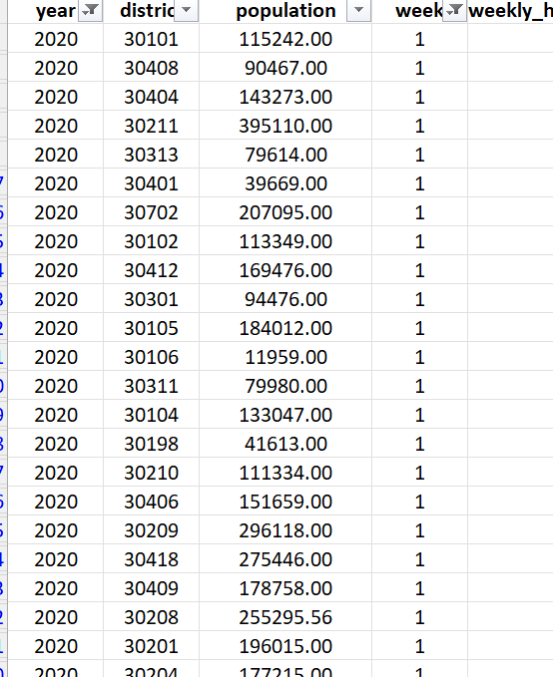
Running Tool
Running the entire data found to be computationally intensive
Mitigations taken
install the WHO server, however, IT people unable to fix it
Hosted on EPHI server, but the server has low capacity (low Core)
Tested on Sample districts
5 districts from Amhara region
Then scaled up to 65

Slide 7
Success
Plots for the Cholera Brief

Slide 8

This is the over all cholera case (national) since 2020
The pick time was 2023 followed by 2020
2021-2022 was contained
The red dot line indicates the simple linear forecast (EXCEL)

Slide 9

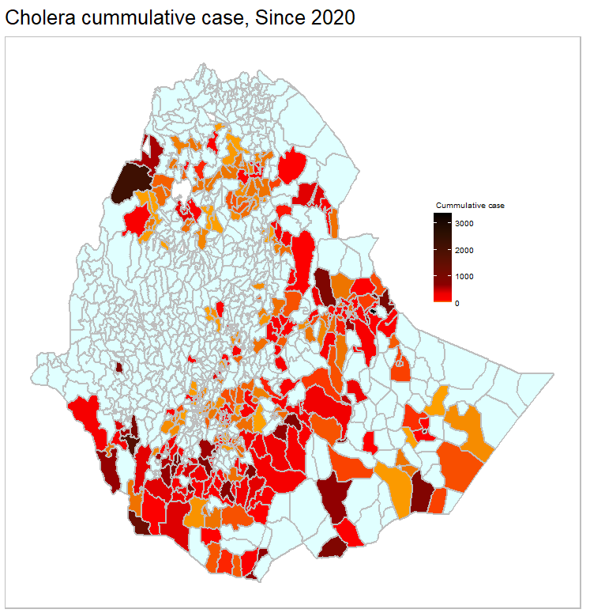
This is the cumulative cholera case distribution from 2020 to week 32, 2024
The value ranges from 0 (light blue) to 3375 (dark red)
A total of XXX districts with in XX regions affected
Max value => Jigjiga town followed by Quara (2229)

Slide 10
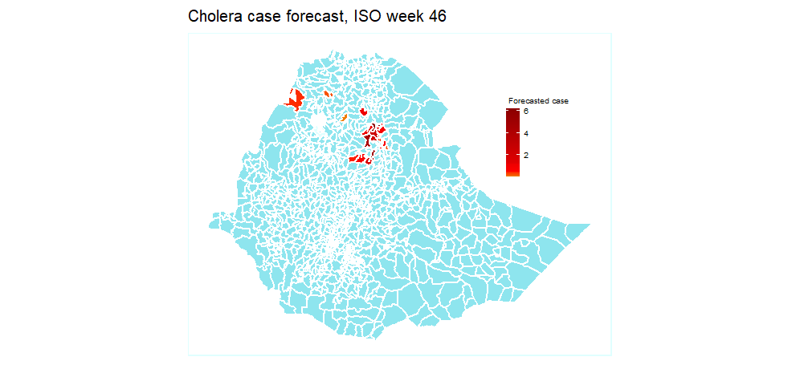
Forecast value for 20 randomly selected districts
This is the forecasted value after 8 weeks, ISO week 46
Indicates 0 to 7 cases per district expected at week 46
However, another week could have higher forecasted case

Slide 11
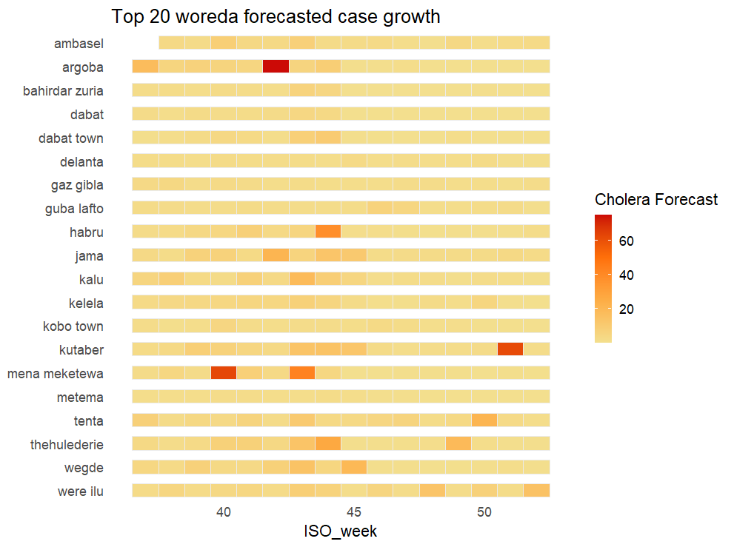
The case load distribution for 20 districts
Argoba and Mana Meketewa has higher forecasted case
Most districts has shown only few forcast

Slide 12
Summary of update
Among two options, the NB model performance found better (considering at majority of districts)
Tested for 20 randomly selected districts and performance is better
Forecasted for week 37- 52, min 0 & max of 75 forecasted cases across the 20 districts

Slide 13
Challenge & Way Forward
Some programming challenge still persist.
E.g the ZIF model extra zero parameter. Scale of the RR is the covariate plot not seems correct.
However this don’t affect the brief template production, because we need the forecast case
Need to improve accuracy
Scale up for the entire district (how?)
Look possible way (if any) to simplify shiny
Work on server configuration
Partitioned analysis (last option)
Produce first draft

Slide 14
Question for discussion?

Slide 15
Thanks

